Slide 1
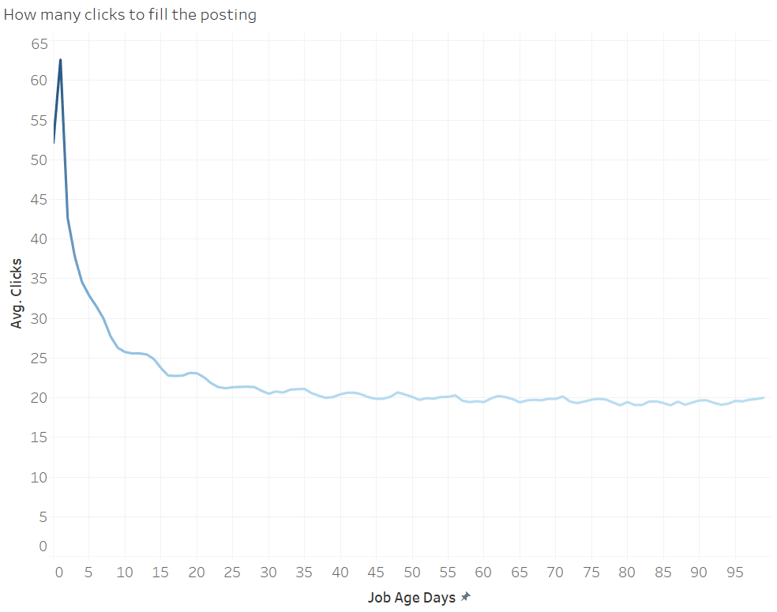

Slide 2
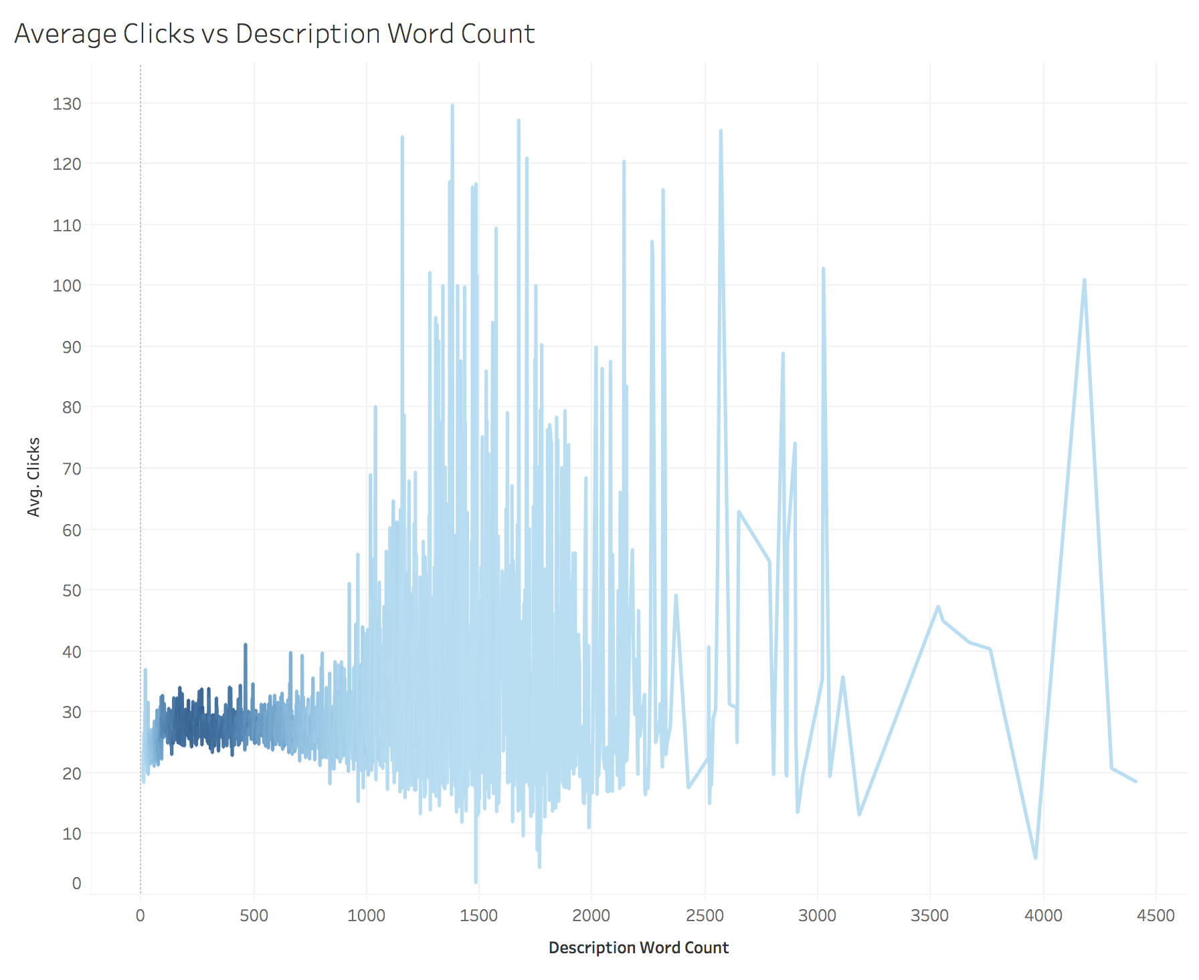

Slide 3
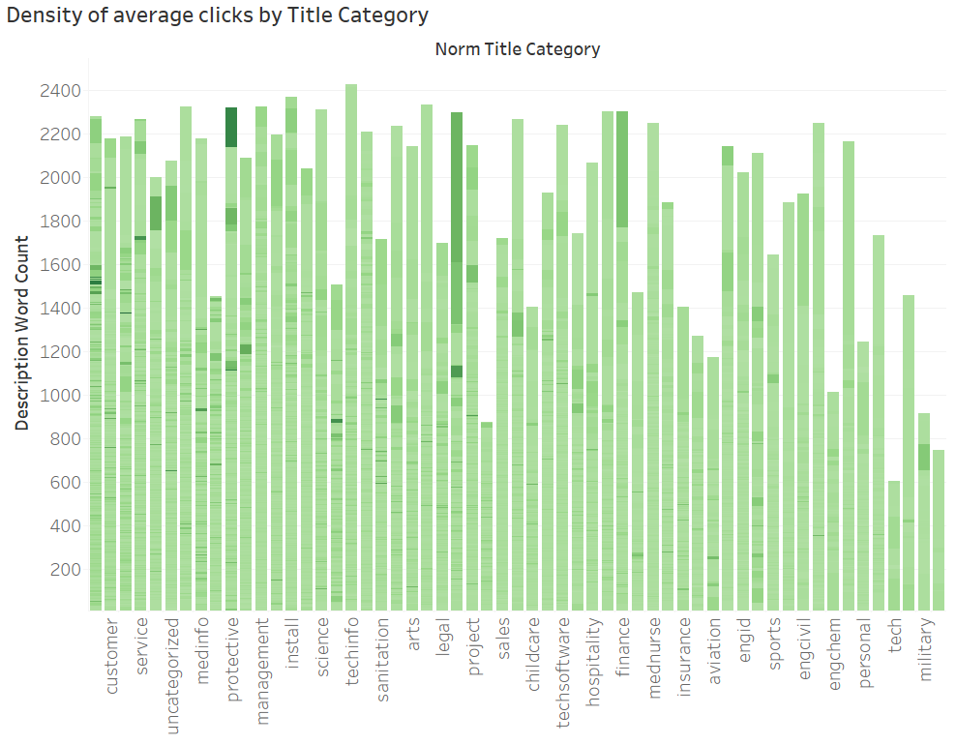
Industry Title
Social Science | 31.5%
Transport | 29.2%
Admin | 19.7%
Medinfo | 18.2%
Warehouse | 12.4%

